Slide 1
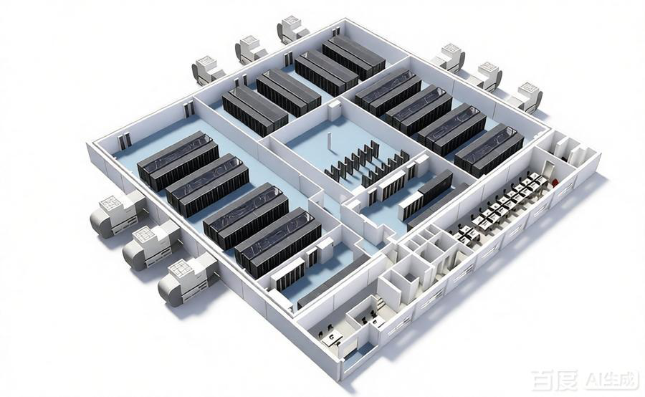
Overview of Prefabricated products
Coolnet Digital Infrastructure | Full Lifecycle Green Solution
The Coolnet prefabricated data center is built on three core modules: IT Computing, Cooling & HVAC, and Power & Distribution. All systems—including enclosures, aisles, power, and cooling—are pre-installed and tested at the factory. On-site, only water and power connections are needed to start operation. It is a standardized, full-stack solution designed for high-density computing.
Features:
Full-Link Integration — Computing, power, cooling integrated in one; no secondary on-site integration
Factory Pre-Installation — Pre-installed & commissioned under full operating conditions
Ultra-Simple Delivery — Only external interfaces to connect; no wet work, no scattered installation

Slide 2
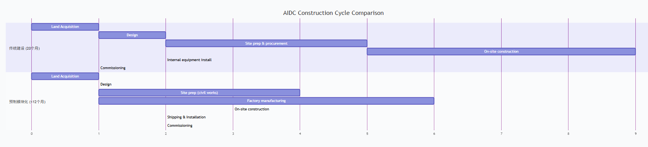
Overview of Prefabricated products
Accelerating AIDC Delivery with Modular Solutions
Application
🤖 AI Computing Clusters | 🏢 IDC Computing Campuses | 📡 Edge Computing Nodes | 🏛️ Government & Smart City
🏦 Finance, Healthcare & Education | 🔄 Legacy Data Center Upgrades | 🚨 Emergency & Disaster Recovery | ⚡ Industrial & Energy Outdoor Sites
🚀 Fast on-site deployment — Parallel prefab + civil works, delivery efficiency improved by 40%
🔒 Stable & Controllable Quality — Standardized workshop production
📈 Flexible Deployment & Expansion — Modular, scalable from small to large
🌱 Green & Low-Carbon — Minimal on-site work, aligned with green computing

Slide 3
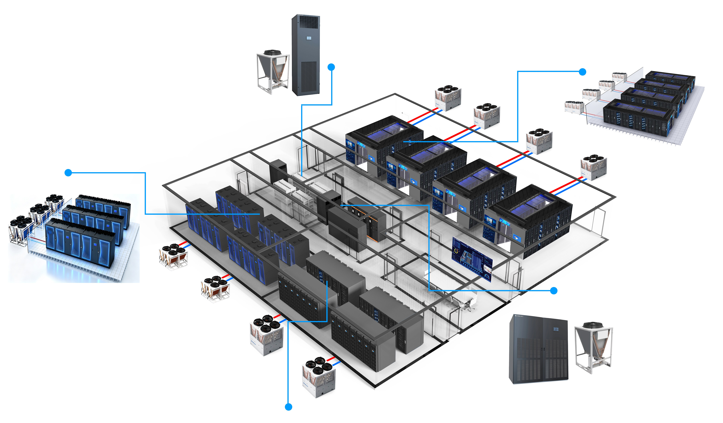
1
Coolnet Full-Scenario Air-Cooled Solution
Part
电池间
Cool-smart系列
氟泵精密空调
Main IT Room
Multi-split Refrigerant Unit+Heat-pipe In-row AC+Meta-Row Series Modular Data Center
Main IT Room
Refrigerant pump modular condenser+ In-row PAC+ Meta-Rack series Cabinet DC
配电间
Cybermaster系列
氟泵房间精密空调
Main IT Room
Multi-split Refrigerant Unit+Heat-pipe rear-door AC+Single-row Sever Rack

Slide 4
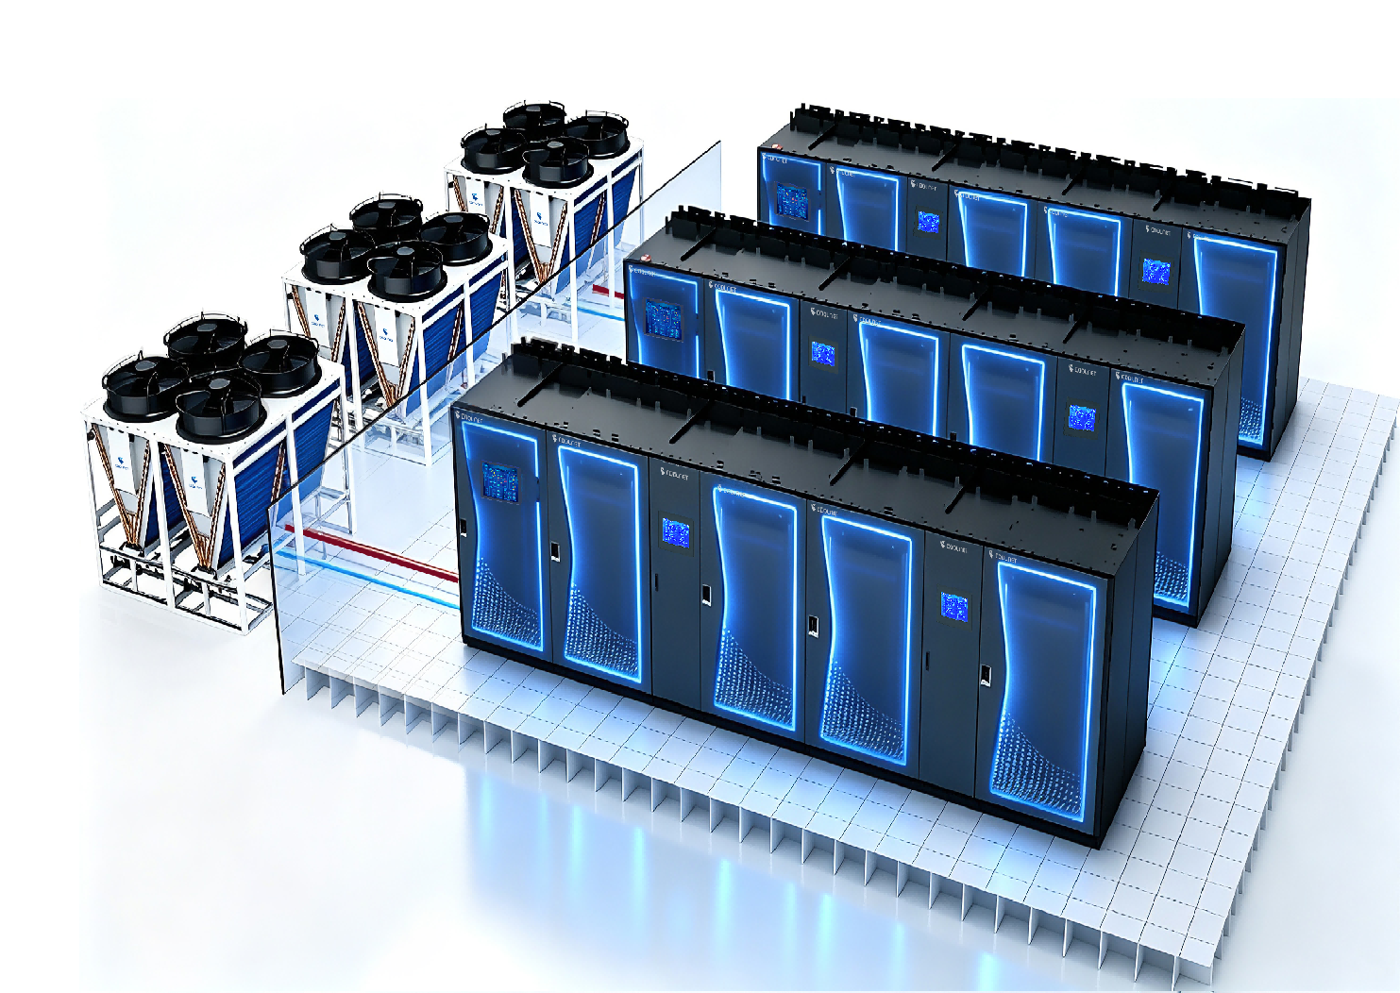
2
Edge Coumpting
Part
Meta-Rack Series Single-Row Micro Data Center
MetaRack Solutions
Rack configuration | Rack heat load | Rack Qty | Total heat load
 | 10KW | 5 pcs | 50KW
Cooling configuration | PAC model | PAC Qty | Redundancy | Energy-saving method
 | CLA050F | 2 | 1+1 | Fluorine pump free cooling
The Meta-Rack Series is a single-row, all-in-one micro data center that combines rack infrastructure, power supply and distribution, precision cooling, environmental monitoring and management, and fire protection in one highly modular, fully integrated enclosure. Purpose-built for edge computing and branch sites, it delivers enterprise-grade reliability in a compact footprint — deployable in days, not months.
Coolnet single-rack and multi-rack solutions, equipped with fluorine pump free cooling in-row air conditioners
Load for single rack≤15kW

Slide 5
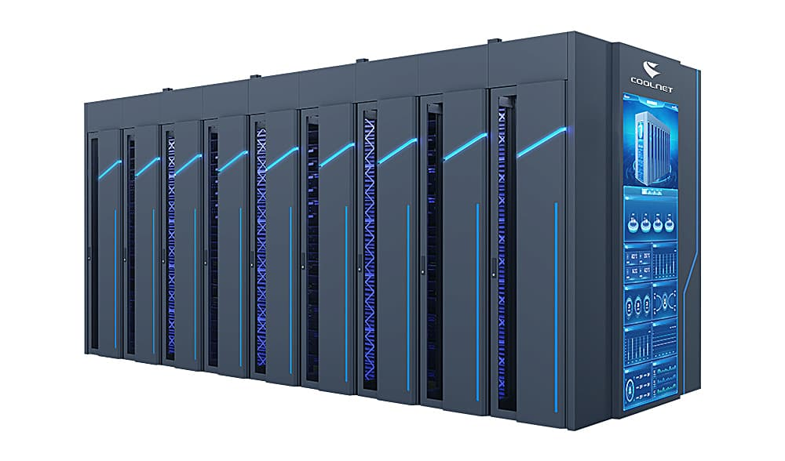
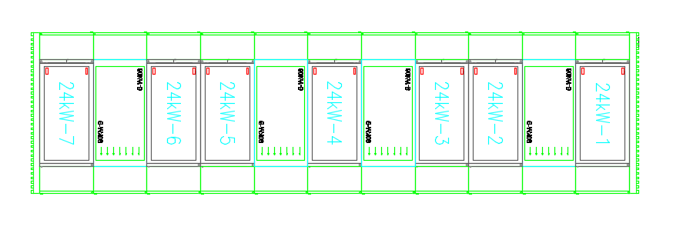
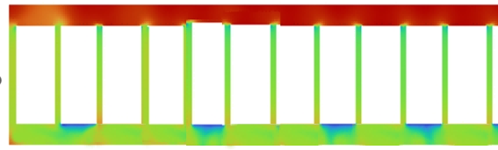
3
AI computing Pod
Part
Core solution description:
Adopting a fully enclosed hot/cold aisle containment airflow design, the core objective is to minimize cooling waste and enhance server heat dissipation efficiency through airflow containment technology.
Cold-aisle containment: Encloses the cold airflow at the server rack's air intake side to prevent cold air from dispersing or mixing with hot air, ensuring that the air drawn into the servers remains consistently cool;
Hot-aisle containment: Encloses the hot airflow at the server rack's exhaust side to prevent hot air from recirculating into the cold aisle, while facilitating the centralized collection and routing of hot air to air conditioning units for cooling.
AI Computing pod solution
Rack configuration | Heat load/per rack | Rack Qty | Total heat load
 | 24KW | 7pcs | 168KW
Cooling configuration | PAC Model | PAC Qty | Redundancy | Energy-saving method
 | CLA060F | 4pcs | 3+1 | Fluorine pump free cooling
Temperature Cloud Map:
a. Cold aisle (rack intake side) shown in green/blue: lower temperature, stable cold-air supply.
b. Hot aisle (rack exhaust side) shown in red/orange: hot air effectively contained, no cold/hot mixing, clear and efficient heat dissipation path.
Coolnet Computing Pod Solution, adopt enclosed Cold & Hot Aisle Containment.
Load for single rack≤30kW

Slide 6
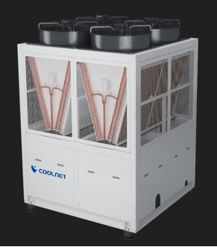
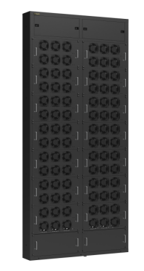


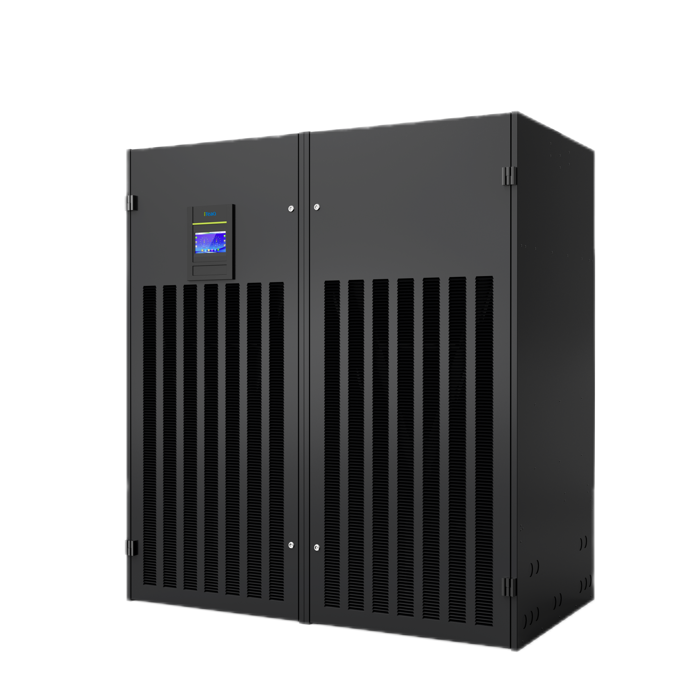
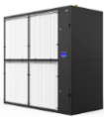
4
Medium-Large Data Center(Air-cold)
Part
Multi-Split Precision Air Conditioning Unit
Combining compressor and refrigeration pump in one modular outdoor unit ， the unit integrates three cooling modes: full variable frequency fluorine pump natural cooling mode, variable frequency fluorine pump + variable frequency compressor hybrid cooling mode, and full variable frequency compressor cooling mode
Fully variable frequency design keeps room temperature fluctuation within < ± 2°C
Oil-free terminals enable efficient and reliable operation over long piping distances and large height differences.
Double-loop, three-mode automatic switching prioritizes natural cooling for high efficiency and energy saving
Independent natural cooling coil improves energy efficiency in low temperature environments
Self-developed intelligent control system ensures fault self-diagnosis
Highly integrated outdoor unit saves 30%+footprint
热管近端风墙
热管背板风墙
热管列间空调
热管房级空调
热管房级风墙

Slide 7
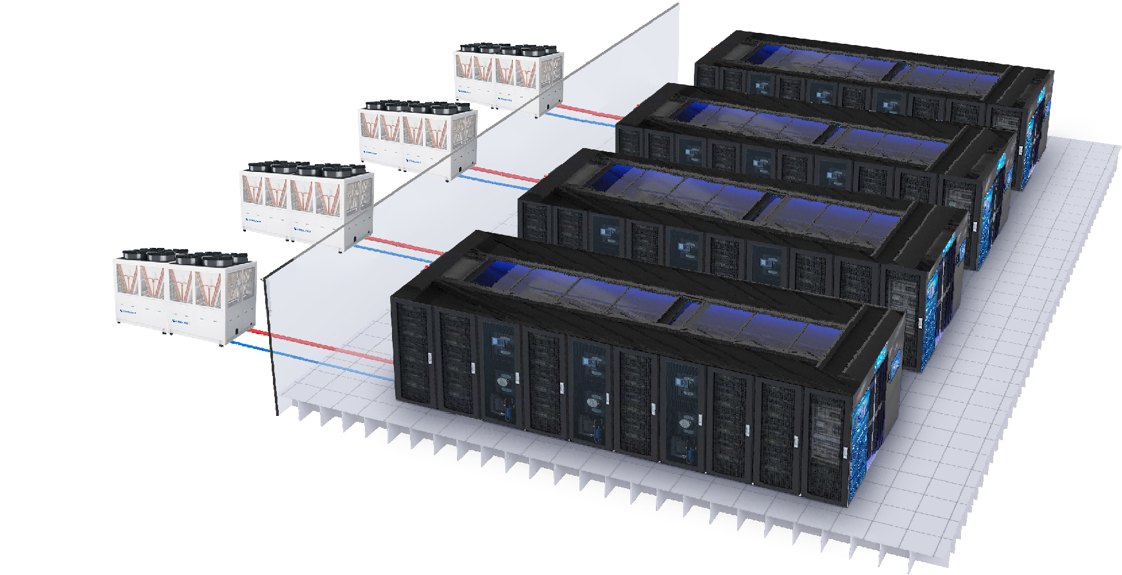
4
Medium-Large Data Center(Air-cold)
Part
coolnet Meta-Row Series intelligent modulare data center integrated power distribution, Cooling,Rack , Asile , monitoring, and linkage mechanisms to form an intelligent containment, significantly enhancing power reliability and cooling energy efficiency. Cooling close to heat sources and effective reduction of module PUE value as low as 1.2
MDC+Ceiling-suspended Multi-split Heat Pipe Unit+Heat Pipe In-row AC
Rack configuration | Heat load/per rack | Rack Qty | Total heat load /per set
 | 25KW | 12 | 300
Cooling configuration | Heat-pipe In-row AC | Qty | Redundancy | Energy-saving method
 | CLA060H | 6 | 5+1 | Fluorine pump free cooling
 | Ceiling-suspended Multi-split Heat Pipe Unit | Qty | Redundancy | Energy-saving method
 | CNQXF300 | 2 | 1+1 | Fluorine pump free cooling
Coolnet MetaRow MDC+ Multi-split refrigerant Unit+ In-row AC
Load for per rack≤25kW
modular design ,fast expanding with multi-module for the needs of large-scale data centers.
Factory prefabrication and pre-commissioning, plug and play on site;
Standardized components, de-engineering, and overall delivery
Adopt mult-split refeigerant unit with free cooling, annual PUE as low as 1.1 in cold area .

Slide 8
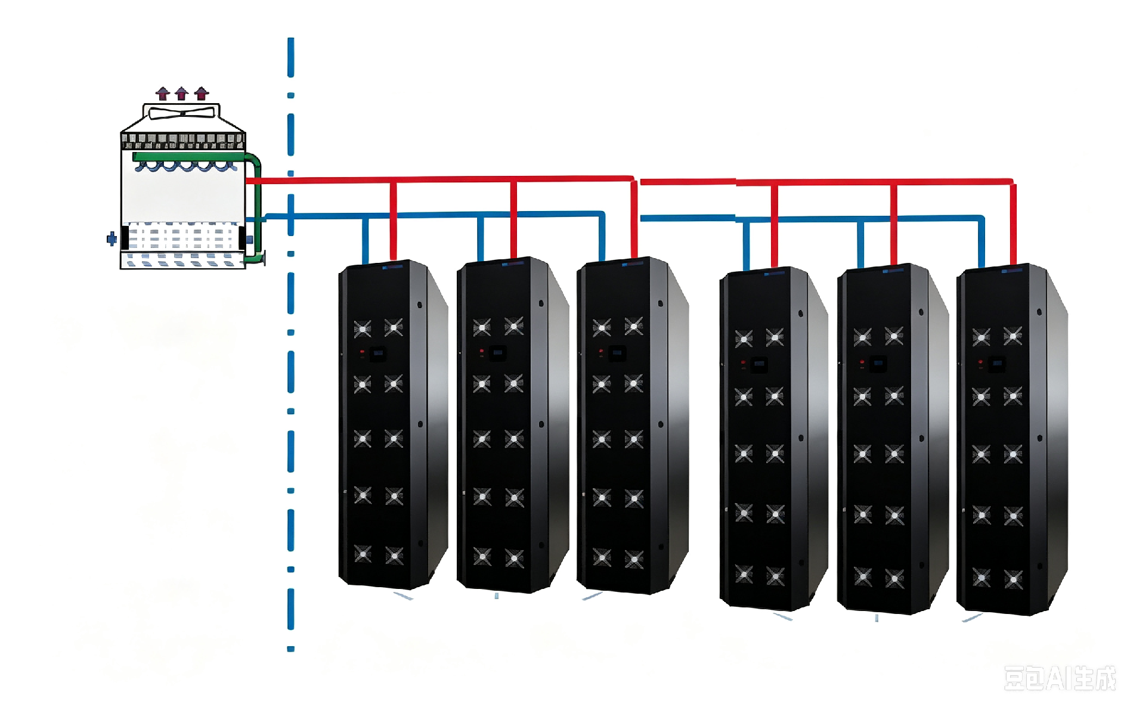
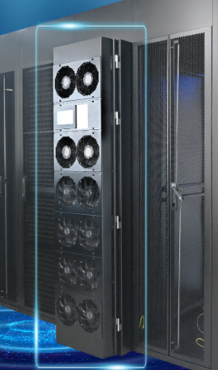
5
Medium-Large Data Center(Air-cold)
Part
Single-row Rack+Ceiling-suspended Multi-split Heat Pipe Unit+Heat Pipe Rear-Door PAC Solution
Rack configuration | Heat load/per rack | Rack Qty | Total heat load
 | 58 | 40 | 2320
Cooling configuration | Heat pipe rear-door AC | Qty | Redundancy | Energy-saving method
 | HPX060D | 40 | / | Fluorine pump free cooling
 | Ceiling-suspended Multi-split Heat Pipe Unit | Qty | Redundancy | Energy-saving method
 | CNQXF500 | 5 | 4+1 | Fluorine pump free cooling
Coolnet Ceiling-suspended Multi-split Heat Pipe Unit+Heat Pipe Rear-Door PAC Solution
Load for per rack≤60kW
Ceiling-suspended Multi-split Heat Pipe
Outdoor Unit
Heat pipe rear-door precision AC

Slide 9
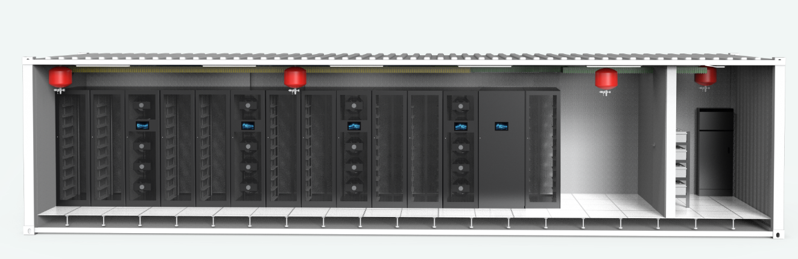
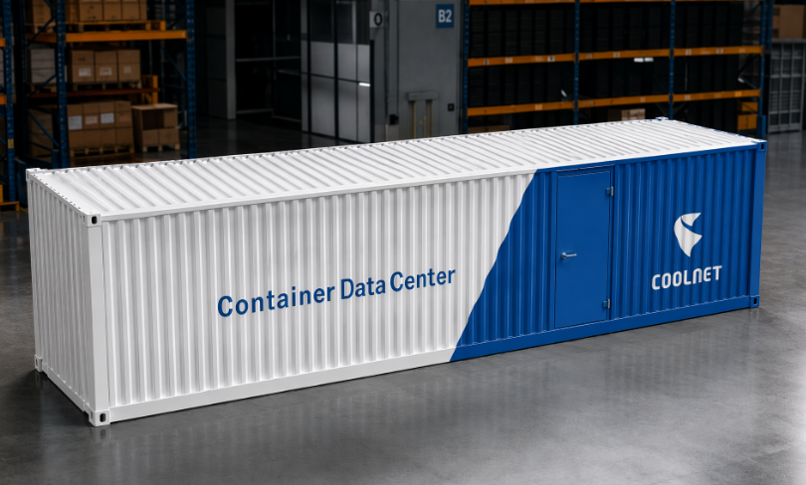
6
预制化集装箱数据中心
Part
预制化集装箱数据中心核心优势
•建设周期短，快速交付业务
•部署灵活，可弹性扩容
•工厂标准化制造，品质可控
•一体化集成，系统完整度高
Coolnet预制化集装箱数据中心，搭载氟泵自然冷列间空调单柜负载支持≤25kW
集装箱数据中心解决方案
机柜配置 | 单柜密度 | 总机柜数 | 总热负荷
 | 10KW | 8台 | 80KW
制冷系统配置 | 空调型号 | 空调数量 | 主备形式 | 节能方式
 | CLA030F | 4 | 3+1 | 氟泵自然冷

Slide 10
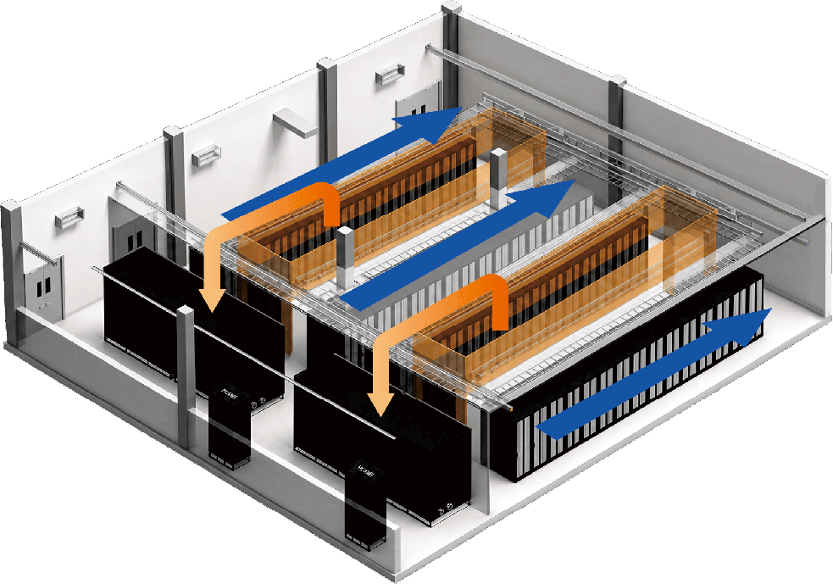
8
液冷算力数据中心-风墙
Part
核心优势：
水平弥散式送风，无需架空地板，快速部署，降低制冷系统成本达10%
超大换热面积低风阻盘管，风机功耗下降50%
单位面宽制冷量提升66%，算力容量提升30%
风墙数据中心解决方案
机柜配置 | 单套微模块 单柜密度 | 单套微模块 总机柜数 | 单套微模块 总热负荷 | 两套微模块 总热负荷
 | 10KW | 40台 | 400KW | 800KW
制冷系统配置 | 空调型号 | 空调数量 | 主备形式
 | HPS300CW | 4 | 3+1
Coolnet封闭热通道微模块+风墙方案
单柜负载支持≤25kW

Slide 11
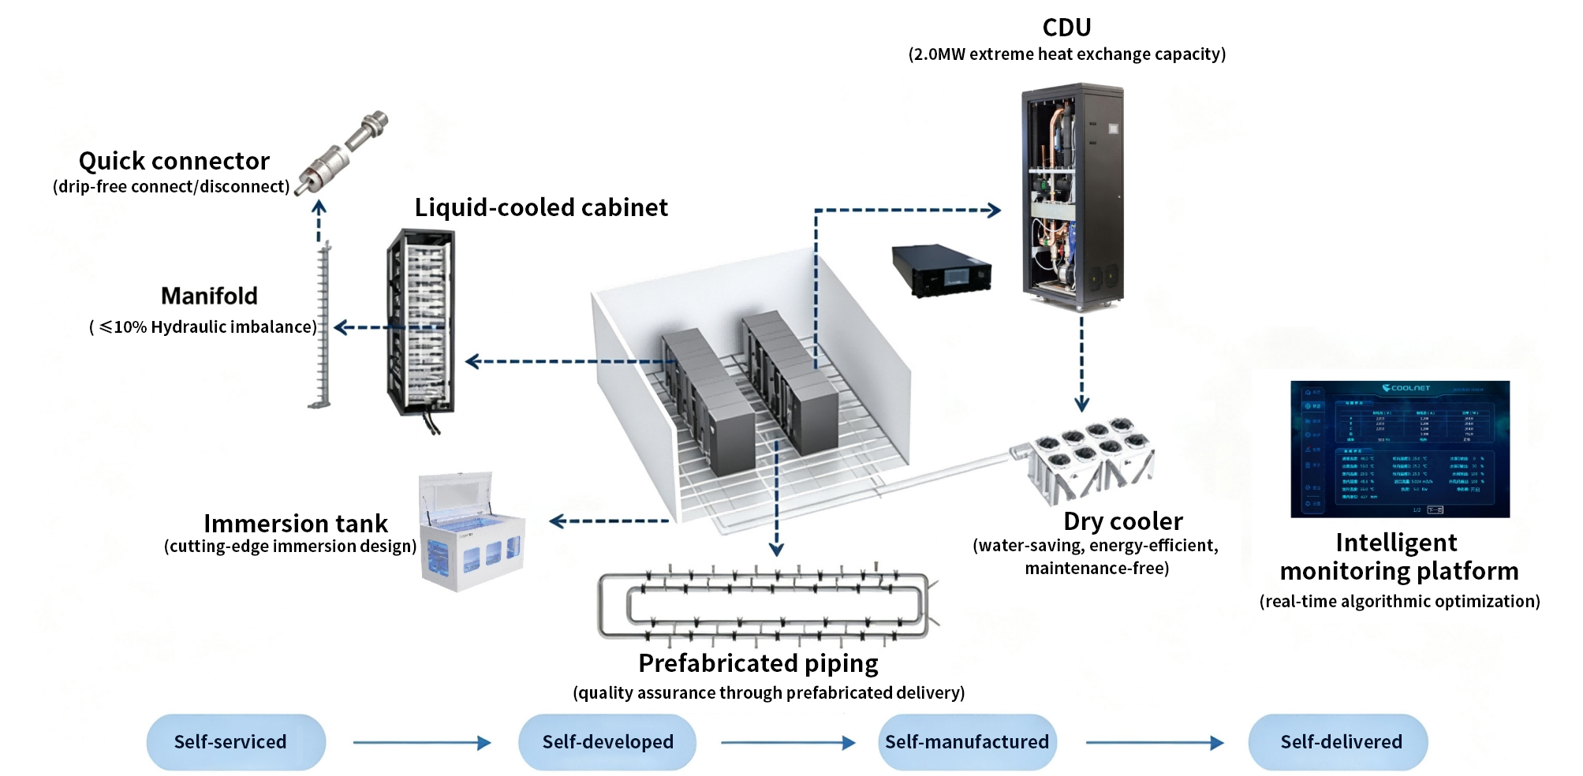
6
Coolnet Full-Scenario, Full-Chain Liquid-Cooled Solution
Part

Slide 13
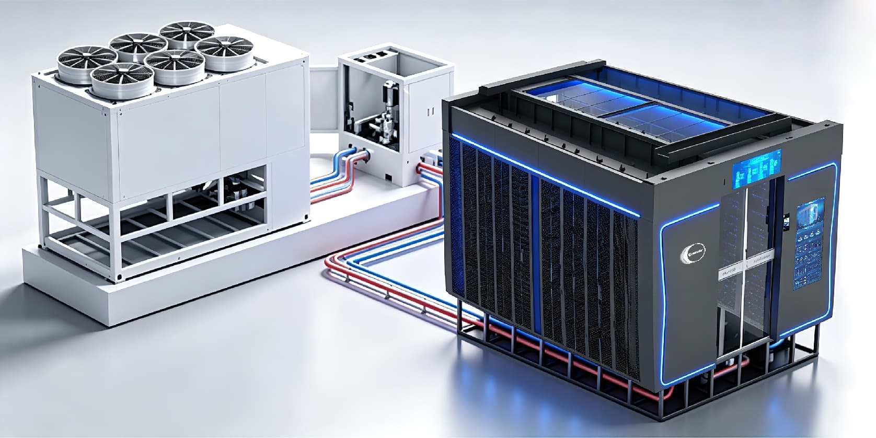
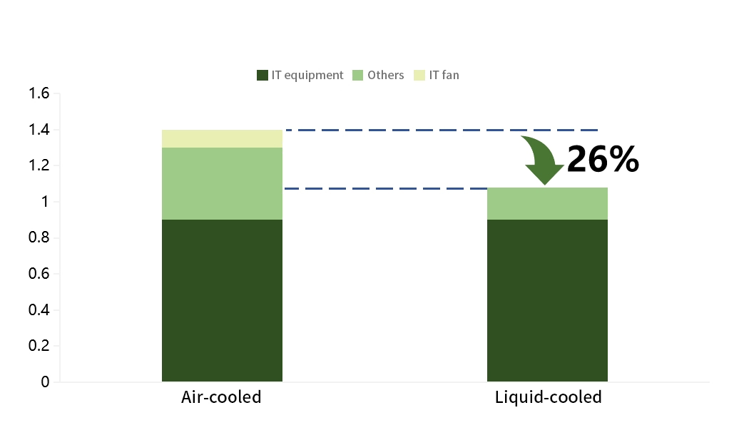
8
Liquid-cooled computing data center
Part
Architecture Overview：
Liquid side:Primary side water temperature 35–45°C, secondary side water temperature 40–50°C. Outdoor Dry cooler+CDU+Secondary-side liquid cooling cabinet
Fluorine pump In-row PAC
Coolnet liquid-cooled Modular Data Center/Container Data Center solution; supports a load of ≥100 kW per rack.
Coolnet Liquid-cooling MDC Solution
Server-side configuration | Server Type | Heat load/per rack | Computing Rack Qty | IT Rack Qty | Network Rack Qty
 | B300 | 105KW | 16 | 128 | 2（1 active+1standby）
Liquid-cooling side configuration | CDU Model | CDU Qty | Redundancy
 | HP-CDU800T | 3 | 2+1
AC Cooling configuration | PAC Model | PAC Qty | Redundancy
 | CLA60F | 7 | 6+1
Outdoor configuration | Dry cooler | Qty | Redundancy
 | HP-DC800 | 3 | 2+1

Slide 14
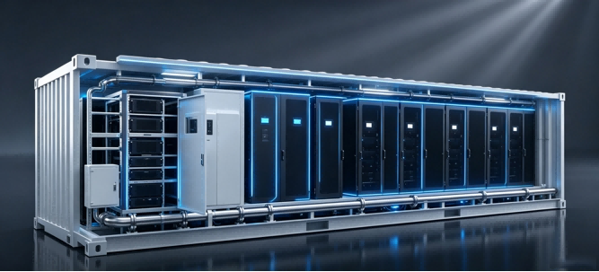
9
Liquid-cooled computing data center
Part
Architecture Overview:
Liquid side: Primary circuit water temperature 35–45°C; secondary circuit 40–50°C.
Outdoor dry cooler + CDU + secondary-side liquid-cooled cabinets.
Fluorine pump in-row PAC units.
Coolnet liquid-cooled Modular Data Center/Container Data Center solution; supports single-cabinet loads of ≥100 kW.
Coolnet Liquid-cooling CDC Solution
Server-side configuration | Server Type | Heat load/per rack | Computing Rack Qty | IT Rack Qty | Network Rack Qty
 | B300 | 105KW | 6 | 48 | 2（1 active+1standby）
Liquid-cooling side configuration | CDU Model | CDU Qty | Redundancy
 | HP-CDU600R | 2 | 1+1
AC Cooling configuration | PAC Model | PAC Qty | Redundancy
 | CLA60F | 4 | 3+1
Outdoor configuration | Dry cooler | Qty | Redundancy
 | HP-DC300 | 3 | 2+1

