Slide 1
Version No.:CN240704(2.0V)
Innovation and Precision
Data Center/ IT Equipment Room
Cool-Row
HEFEI COOLNET POWER CO.,LTD
Add:Building F1, Xingmengyuan Mansion, High-tech Zone, Hefei City, Anhui Province, China
Tel: +86-551-65568275 Fax:+86-551-65568275
Website: www.coolnetpower.com
The name of Coolnet and logo are the registered trademark only for Coolnet.
©2024 by Coolnet company
There is no notification on any modification of the documents.
In-Row Precision Air Cooling

Slide 2
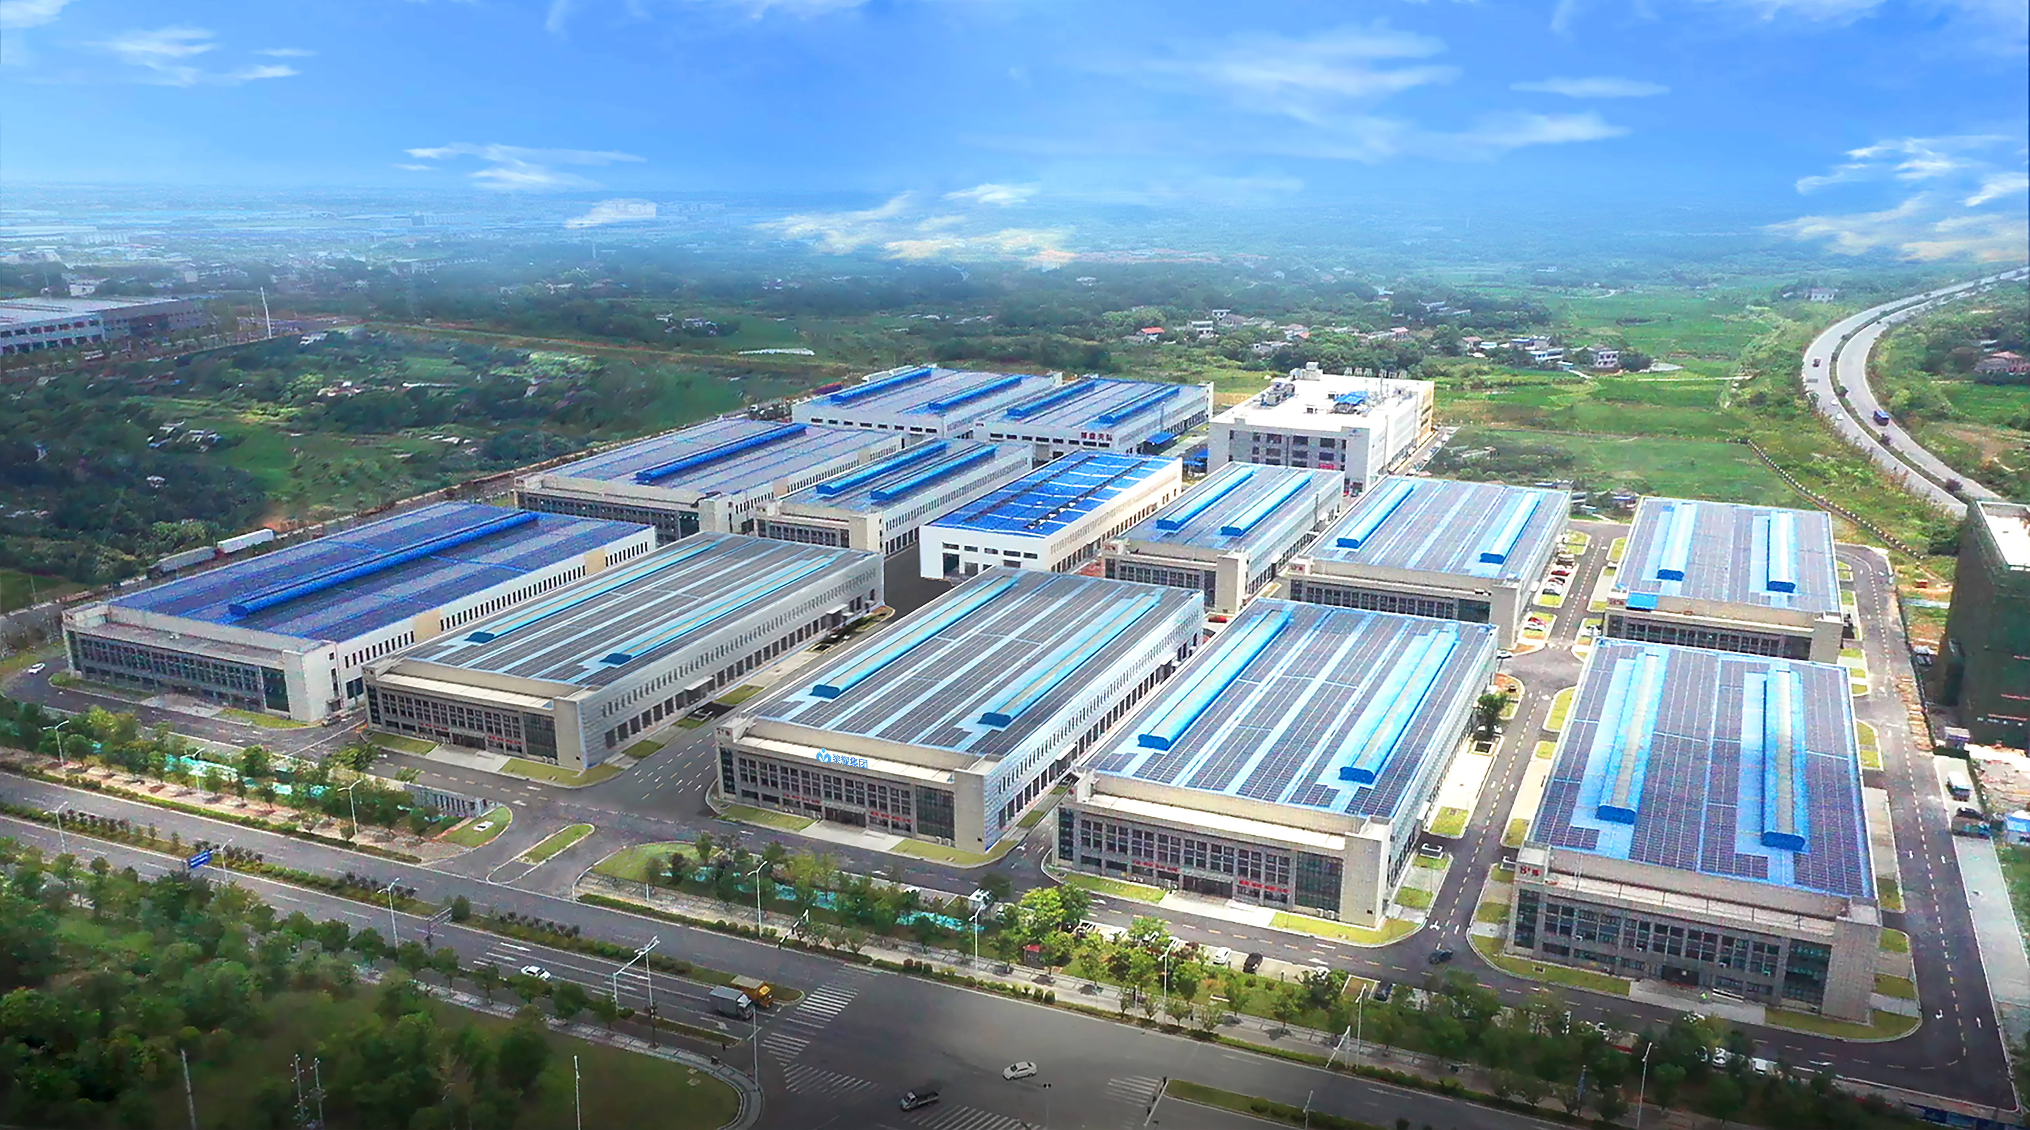
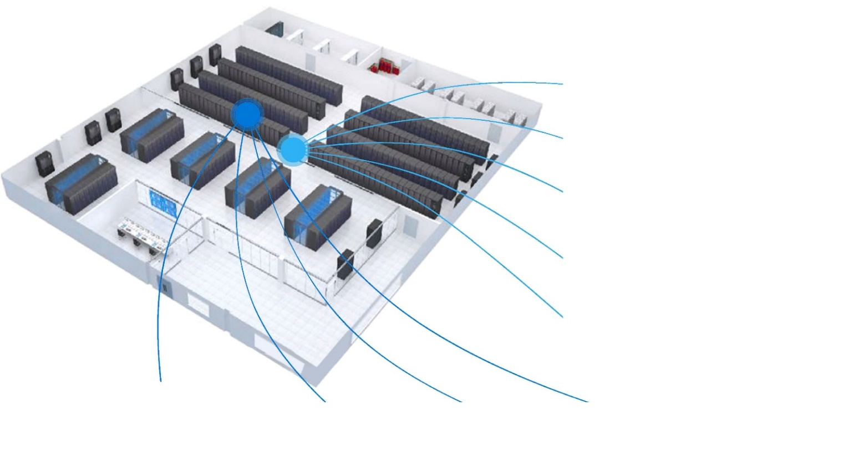
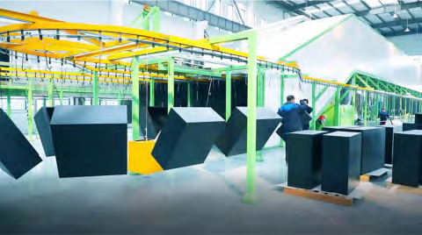
EFFICIENT COOLING SOULTION
FOR MODULARIZED DATA CENTER
COMPANY PROFILE
Efficient cooling solution for modularized data center
High heat density data centers
container data center
modularized data centers
Improving cooling system EER
reducing data centers PUE
Matching cold/hot aisle deign
Coolnet focuses on the R&D, production, and application of data center integrated solutions. As technical consulting, product supply, system integrator, and service provider, it is committed to serving customers in the fields of communication equipment rooms, data centers, smart construction, and energy management.
Our solutions include data center temperature, humidity, and energy-saving solutions, small and medium-sized computer room temperature control solutions, micro-module data center solutions, micro-module cabinet solutions, container, and modular data center solutions, communication outdoor cabinet temperature control and energy saving Solutions, cabinet temperature and humidity, and energy-saving solutions.
Has rich research and manufacturing experience in the field of data center equipment, with world-class laboratories, production testing equipment, and a complete line of key equipment rooms. And passed the ISO9001 quality management system certification, ISO14001 environmental management system certification, and the products have passed CE certification, CCC certification, CQC certification, CRAA quality certification, etc.
We are committed to "paying attention to customer needs and realizing customer value" and establishing a win-win cooperation pattern with customers. To become your most trustworthy, most grateful, most professional, most practical, and most reliable partner with the best vision. We will "make every effort to provide value for money products and services to make customers more competitive", and continue to explore and innovate.
Clos to Heat Source
No Rasied Floor or Limited Floor Height
Energy Efficiency Requirement
Dynmaic Heart Load
Constantly Expansion
Increasing Heat Density
Virtualization
Increasing IT Demand
Cloud Computing
High/Integrated Sever/Blade Sever
1
Energy Efficiency Requirement
High integrated
Server/Rlad Server
Cloud Computing
Virtualization
XRow is an adaptive row-based coo|ing system pIaced closetothe heat source and ideal for rack level cooling solution for data center
01
02

Slide 3
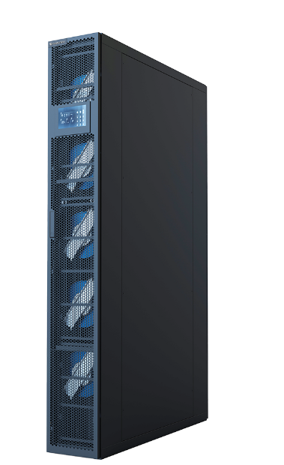
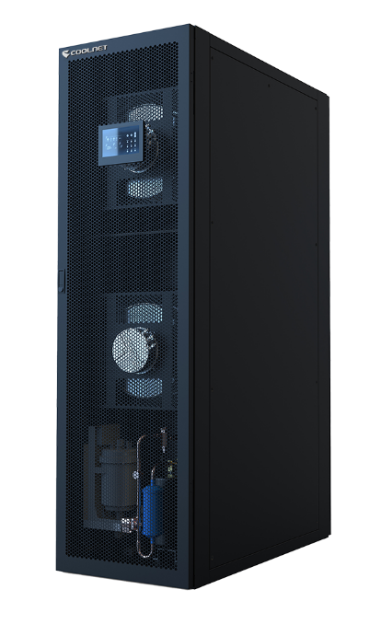
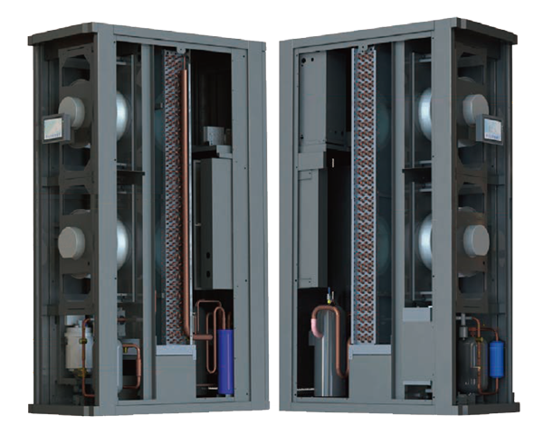
COOL-ROW UNIT INTRODUCTION
COOL-ROW UNIT CHARACTlSTlCS
Introduction
Advanced Controller
Advanced team work function, Up to 16 remote temperature/humidity sensors Standard RS485 communication interface, optional SNMP and TCP/IP interfaces
Efficient EC fan system
Saving 20%-30% energy compared to traditional AC motor Soft-startup function, Low startup current
Adjust rotary speed automatically according to cooling requirments and airflow pressure, and provide airflow required
N+1redundancy configuration of fans, ensure the airflow in case of any fan fault Easy-maintenance designed
High Efficiency Compressor System
R410A refrigerant
Adopting scroll compressor with high reliability and energy efficiency ratio
Electronic Expansion Valve
Adjust the throttle of valve smoothly to save the energy
Wide range og operations, which can help reduce the superheat degree and improvde EER Realize cooling capacity and heat load precise matching
Qucik response, realize the precise cooling
COOLNET Row Cooling Precision Air Conditioning is an ideal product for inter-column cooling in green data centers. It has the industry's best cooling efficiency. The variable frequency scroll compressor uses environmentally friendly refrigerant R410A. It has excellent intelligent control and performance. Flexible cooling capacity design: can be used in 20%~100% adjustment of cooling capacity, which greatly improves the energy efficiency of ordinary air-cooled units by 33.3%~50%. The 7-inch touch screen can comprehensively display various data in the computer room and related working conditions of the unit.
300MM
Applications
Single rack with power larger than 3kW
High heat density computer room
Modular DC
Container type DC
DC with low PUE
Hot spot reconstruction
Options
Transfer switch for Dual Power Input GPRS SMS alarm
Low-temperature startup kits
Wired Temperature/humidity sensors Tree-way water valve
600MM
03
04

Slide 4
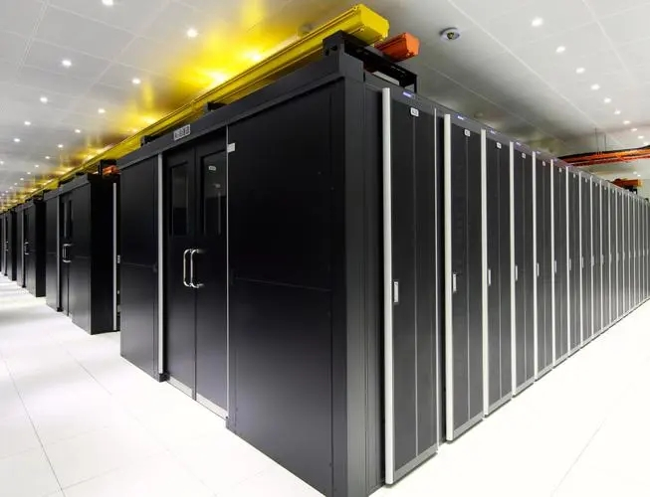
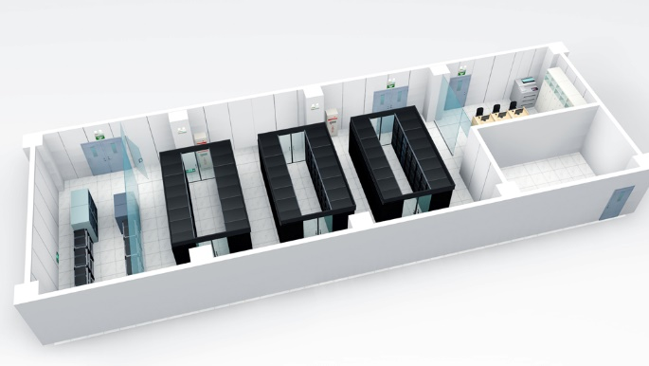
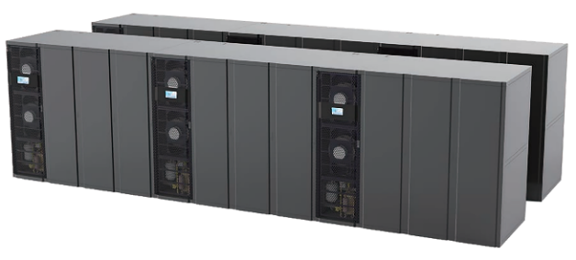
Technical Data Of Cool-Row Series DX Unit
Technical Data Of Cool-Row Series Of CW Unit
Model | CRA013 | CRA025 | CRA030 | CRA040 | CRA050 | CRA060
Air Supply | Front/Side | Front/Side | Front/Side | Front/Side | Front/Side | Front/Side
Power Supply | 380Vac/3Ph/50Hz | 380Vac/3Ph/50Hz | 380Vac/3Ph/50Hz | 380Vac/3Ph/50Hz | 380Vac/3Ph/50Hz | 380Vac/3Ph/50Hz
Technical Data
Cooling Capacity (kw) | 13.2 | 26.7 | 32.5 | 42.6 | 53.3 | 63. 9
Sensible Cooling (kw) | 13.2 | 26.7 | 32.5 | 42.6 | 53.3 | 63. 9
Maximum Operation Current | 24 | 41 | 44 | 48 | 55 | 59
Compressor
Type | Inverter compressors
Refrigerant | R410A | R410A | R410A | R410A | R410A | R410A
Quantity | 1 | 1 | 1 | 1 | 1 | 1
Fan
Fan Type | EC centrifugal fan | EC centrifugal fan | EC centrifugal fan | EC centrifugal fan | EC centrifugal fan | EC centrifugal fan
Quantity | 4 | 5 | 2 | 2 | 3 | 3
Air Volume (m³/h) | 3200 | 5000 | 6600 | 8800 | 11000 | 12500
Heater
Heat Type | PTC | PTC | PTC | PTC | PTC | PTC
Capacity (kw) | 2 | 3 | 6 | 6 | 6 | 6
Class | 1 | 1 | 1 | 1 | 1 | 1
Humidification
Type | Electrodetype
Capacity (kg/h) | 1.5 | 1.5 | 3 | 3 | 3 | 3
Air Filter | G4 | G4 | G4 | G4 | G4 | G4
Connection Size
Humidifier inlet pipe (in) | G1/2 | G1/2 | G1/2 | G1/2 | G1/2 | G1/2
Drain Pipe Φ (mm) | 19 | 19 | 19 | 19 | 19 | 19
Gas Pip Φ(mm) | 15.88 | 19.05 | 19.05 | 19.05 | 22 | 22
Liquid Pipe Φ (mm) | 9.52 | 15.88 | 15.88 | 15.88 | 19.05 | 19.05
Indoor Dimension-W*D*H (mm)
Dimension | 300*1200*2000 300*1400*2000 | 300*1200*2000 300*1400*2000 | 600*1200*2000 | 600*1200*2000 | 600*1200*2000 | 600*1200*2000
Weight (kg) | 190 | 230 | 280 | 285 | 310 | 330
Note: Standard working conditions: indoor return air dry bulb temperature 37°C, relative humidity 24%, outdoor dry bulb temperature 35°C；
Model | CRCW030 | CRCW040 | CRCW050 | CRCW060
Cooling Capacity (kW) ① | 30.5 | 40.4 | 50.3 | 65.7
Chilled water | 12°C/18°C
Sensible Cooling Capacity (kW) | 30.5 | 40.4 | 50.3 | 65.7
Water Flow （ m3/h） | 4.4 | 5.8 | 7.2 | 9.4
Pressure Drop （kPa） | 55 | 63 | 70 | 78
Air Volume （m3/h） | 5500 | 8000 | 10000 | 12500
Electrode Humidification （kg/h） | 3 | 3 | 3 | 3
Humidification Current （ A） | 10.2 | 3.4 | 3.4 | 3.4
Heater （kW） | 3 | 6 | 6 | 6
Current （ A） | 13.6 | 9 | 9 | 9
Power Supply | 380V/50-60HZ | 380V/50-60HZ
Full Load Current ② | 20 | 12.6 | 14.3 | 14.3
Dimension WxDxH （mm） | 300x1200x2000 | 600x1200x2000
Weight （kg） | 190 | 250 | 275 | 290
Pipe Connection | 32 | 40 | 40 | 40
① Working Conditioning : indoor return air dry bulb temperature 37°C, relative humidity 24%, outdoor dry bulb temperature 35°C ；
② Full Load current for on-site power distribution reference.
Air Cooled Condensor
Model | CY0241 | CY0451 | CY0522 | CY0622 | CY0832 | CY0893
Power Supply | 220Vac/1Ph/50Hz | 220Vac/1Ph/50Hz | 220Vac/1Ph/50Hz | 220Vac/1Ph/50Hz | 220Vac/1Ph/50Hz | 220Vac/1Ph/50Hz
Installation | Horizontal/Vertical | Horizontal/Vertical | Horizontal/Vertical | Horizontal/Vertical | Horizontal/Vertical | Horizontal/Vertical
Fan
Type | Axial flow fan | Axial flow fan | Axial flow fan | Axial flow fan | Axial flow fan | Axial flow fan
Fan | 1 | 1 | 2 | 2 | 2 | 3
Speed Mode | Stepless speed | Stepless speed | Stepless speed | Stepless speed | Stepless speed | Stepless speed
Condenser Dimension-W*D*H (mm)
Dimension | 1115*1065*520 | 1315*1165*545 | 2025*1015*520 | 2125*1065*545 | 2425*1165*545 | 2625*1165*545
Weight (kg) | 91 | 115 | 156 | 182 | 226 | 252
05
06

